Slide 1
Information Assurance and security

Slide 2
information assurance (IA)
is the practice of assuring information and managing risks related to the use, processing, storage, and transmission of information.
Information assurance includes protection of the
Availability: timely, reliable access to data and information services for authorized users.
Integrity: protection against unauthorized modification or destruction of information.
Confidentiality: assurance that information is not disclosed/ closed to unauthorized persons.

Slide 3
Authentication: security measures to establish the validity of a transmission, message, or originator.
Non-repudiation: assurance that the sender is provided with proof of a data delivery and recipient is provided with proof of the sender’s identity, so that neither can later deny having processed the data.

Slide 4
What's the difference between authentication and authorization?
Authentication confirms that users are who they say they are.
Passwords Usernames and passwords are the most common authentication factors. If a user enters the correct data, the system assumes the identity is valid .
Biometrics A user presents a fingerprint or eye scan to gain access to the system.
Authorization gives those users permission to access a resource.
Giving someone permission to download a particular file on a server or providing individual users with administrative access to an application are good examples of authorization.

Slide 5
Information security
is not only about securing information from unauthorized access.
Information Security is basically the practice of preventing unauthorized access, use, disclosure, disruption, modification, inspection, recording or destruction of information.
Information can be physical or electronic one. Information can be anything like Your details or we can say your profile on social media, your data in mobile phone.
Thus Information Security spans so many research areas like Cryptography, Mobile Computing, Cyber Forensics, Online Social Media etc.

Slide 6
The difference between information assurance and information security
In short, information assurance focuses on gathering data Information security is about keeping that data safe.
In most organizations, these two jobs are combined into one department or even one worker. You’ll need to understand cyber security, database management and security engineering to succeed in this field.

Slide 7
The difference between Noise, Data, Information, Knowledge
Noise: raw facts with an unknown coding system
Data: raw facts with a known coding system/ have no value.
Information :processed data/have value.
Knowledge :accepted facts, principles that are useful for specific domains.
Knowledge can be the result of inferences produced from simple information facts.

Slide 8
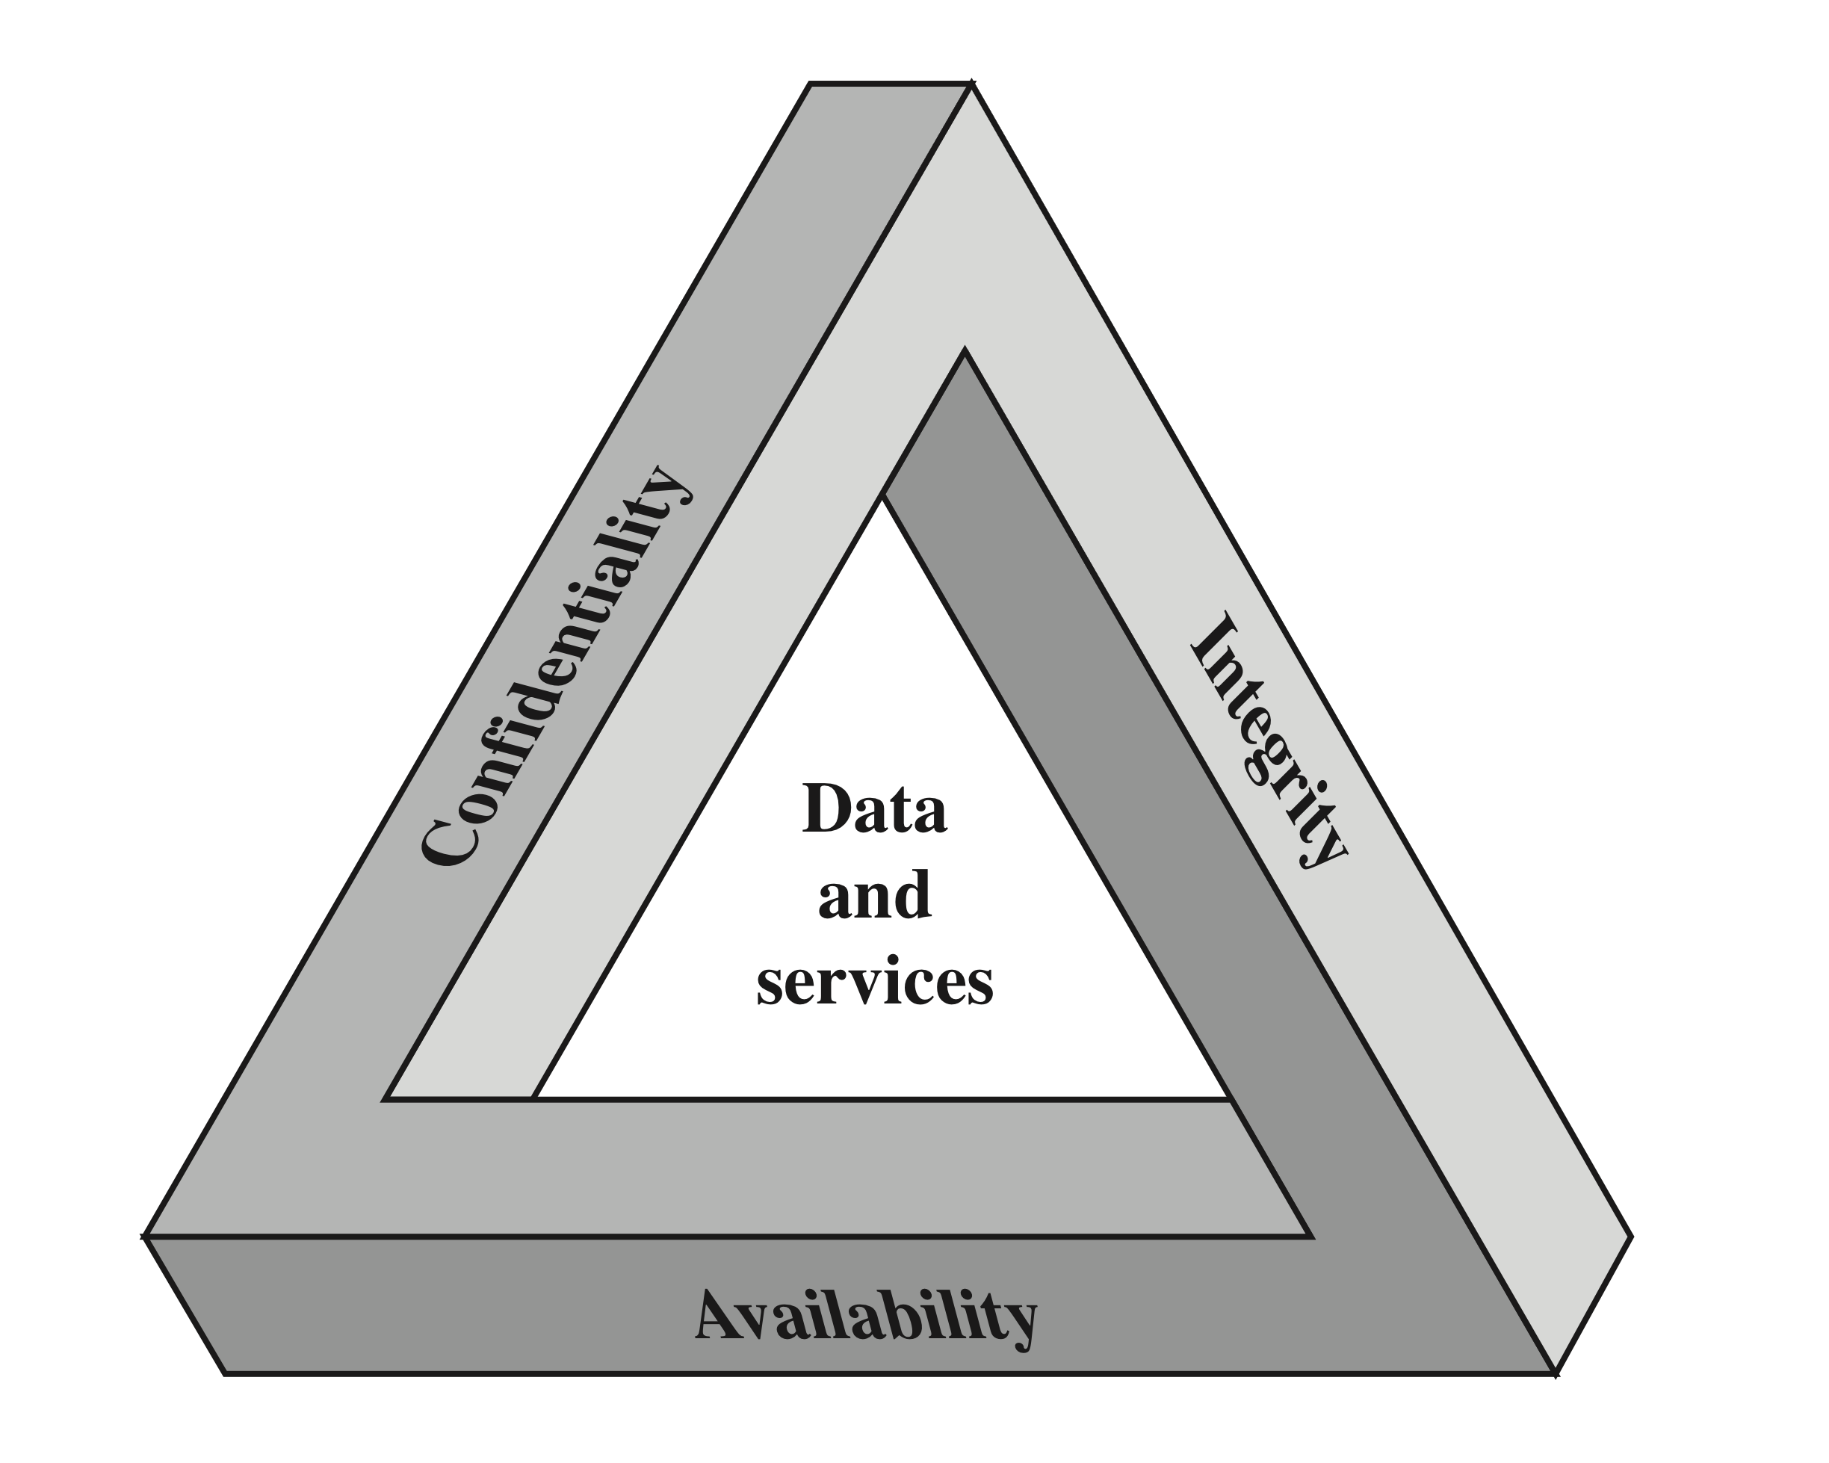
CIA Triad
Adapted from William Stalling, Network Security Essentials, Applications and Standards, Fifth Edition
Notes:
These three concepts form what is often referred to as the CIA triad . The
three concepts embody the fundamental security objectives for both data and for
information and computing services. For example, the NIST Standards for Security
Categorization of Federal Information and Information Systems (FIPS 199) lists
confidentiality, integrity, and availability as the three security objectives for information
and for information systems. FIPS 199 provides a useful characterization
of these three objectives in terms of requirements and the definition of a loss of
security in each category.
• Confidentiality: Preserving authorized restrictions on information access
and disclosure, including means for protecting personal privacy and proprietary
information. A loss of confidentiality is the unauthorized disclosure of
information.
• Integrity: Guarding against improper information modification or destruction,
including ensuring information nonrepudiation and authenticity. A loss of
integrity is the unauthorized modification or destruction of information.
• Availability: Ensuring timely and reliable access to and use of information.
A loss of availability is the disruption of access to or use of information or an
information system.

Slide 9
Computer Security Objectives
Confidentiality
Data confidentiality
Assures that private or confidential information is not made available or disclosed to unauthorized individuals
Privacy
Assures that individuals control or influence what information related to them may be collected and stored and by whom and to whom that information may be disclosed
Integrity
Availability
Assures that systems work promptly and service is not denied to authorized users
Assures that a system performs its intended function in an unimpaired manner, free from deliberate or inadvertent unauthorized manipulation of the system
System integrity
Assures that information and programs are changed only in a specified and authorized manner
Data integrity
Adapted from William Stalling, Network Security Essentials, Applications and Standards, Fifth Edition
Notes:
This definition introduces three key objectives that are at the heart of computer
security:
• Confidentiality: This term covers two related concepts:
Data confidentiality: Assures that private or confidential information is
not made available or disclosed to unauthorized individuals.
Privacy: Assures that individuals control or influence what information
related to them may be collected and stored and by whom and to whom
that information may be disclosed.
•Integrity: This term covers two related concepts:
Data integrity: Assures that information and programs are changed only in
a specified and authorized manner.
System integrity: Assures that a system performs its intended function in
an unimpaired manner, free from deliberate or inadvertent unauthorized
manipulation of the system.
• Availability: Assures that systems work promptly and service is not denied to
authorized users.

Slide 10
Possible additional concepts:
Authenticity
Verifying that users are who they say they are and that each input arriving at the system came from a trusted source
Adapted from William Stalling, Network Security Essentials, Applications and Standards, Fifth Edition
Notes:
Although the use of the CIA triad to define security objectives is well established,
some in the security field feel that additional concepts are needed to present
a complete picture. Two of the most commonly mentioned are as follows:
• Authenticity: The property of being genuine and being able to be verified and
trusted; confidence in the validity of a transmission, a message, or message
originator. This means verifying that users are who they say they are and that
each input arriving at the system came from a trusted source.
• Accountability: The security goal that generates the requirement for actions
of an entity to be traced uniquely to that entity. This supports nonrepudiation,
deterrence, fault isolation, intrusion detection and prevention, and after action
recovery and legal action. Because truly secure systems are not yet an
achievable goal, we must be able to trace a security breach to a responsible
party. Systems must keep records of their activities to permit later forensic
analysis to trace security breaches or to aid in transaction disputes.

Slide 11
Examples of Security Requirements
Confidentiality
Student grade information is an asset whose confidentiality is considered to be highly important by students
Regulated by the Family Educational Rights and Privacy Act (FERPA) in US
Integrity
Patient information stored in a database – inaccurate information could result in serious harm or death to a patient and expose the hospital to massive liability
A Web site that offers a forum to registered users to discuss some specific topic would be assigned a moderate level of integrity
An example of a low-integrity requirement is an anonymous online vote
Availability
The more critical a component or service, the higher the level of availability required
A moderate availability requirement is a public Web site for a university
An online telephone directory lookup application would be classified as a low-availability requirement
Adapted from William Stalling, Network Security Essentials, Applications and Standards, Fifth Edition
Notes:
Confidentiality
Student grade information is an asset whose confidentiality is
considered to be highly important by students. In the United States, the release of
such information is regulated by the Family Educational Rights and Privacy Act
(FERPA). Grade information should only be available to students, their parents,
and employees that require the information to do their job. Student enrollment
information may have a moderate confidentiality rating. While still covered by
FERPA, this information is seen by more people on a daily basis, is less likely to be
targeted than grade information, and results in less damage if disclosed. Directory
information (such as lists of students, faculty, or departmental lists) may be assigned
a low confidentiality rating or indeed no rating. This information is typically freely
available to the public and published on a school’s Web site.
Integrity
Several aspects of integrity are illustrated by the example of a hospital
patient’s allergy information stored in a database. The doctor should be able to
trust that the information is correct and current. Now suppose that an employee
(e.g., a nurse) who is authorized to view and update this information deliberately
falsifies the data to cause harm to the hospital. The database needs to be restored
to a trusted basis quickly, and it should be possible to trace the error back to the
person responsible. Patient allergy information is an example of an asset with a high
requirement for integrity. Inaccurate information could result in serious harm or
death to a patient and expose the hospital to massive liability.
An example of an asset that may be assigned a moderate level of integrity
requirement is a Web site that offers a forum to registered users to discuss some
specific topic. Either a registered user or a hacker could falsify some entries or deface
the Web site. If the forum exists only for the enjoyment of the users, brings
in little or no advertising revenue, and is not used for something important such
as research, then potential damage is not severe. The Web master may experience
some data, financial, and time loss.
An example of a low-integrity requirement is an anonymous online poll. Many
Web sites, such as news organizations, offer these polls to their users with very few
safeguards. However, the inaccuracy and unscientific nature of such polls are well
understood.
Availability
The more critical a component or service, the higher is the level of
availability required. Consider a system that provides authentication services for
critical systems, applications, and devices. An interruption of service results in the
inability for customers to access computing resources and for the staff to access
the resources they need to perform critical tasks. The loss of the service translates
into a large financial loss due to lost employee productivity and potential
customer loss.
An example of an asset that typically would be rated as having a moderate
availability requirement is a public Web site for a university; the Web site provides
information for current and prospective students and donors. Such a site is not a
critical component of the university’s information system, but its unavailability will
cause some embarrassment.
An online telephone directory lookup application would be classified as a low availability
requirement. Although the temporary loss of the application may be
an annoyance, there are other ways to access the information, such as a hardcopy
directory or the operator.

